Slide 1
Licensing & Proper Citation in Open‑Source AI
Nvidia Stock Market History — Ethics & Foundations

Slide 2

Why Licenses & Citations Matter
Enable collaboration with clear, legal reuse rules
Protect contributors (copyright, patents, liability)
Prevent ‘license creep’ and accidental violations
Reward creators via attribution; build reputation
Support reproducibility and community trust

Slide 3
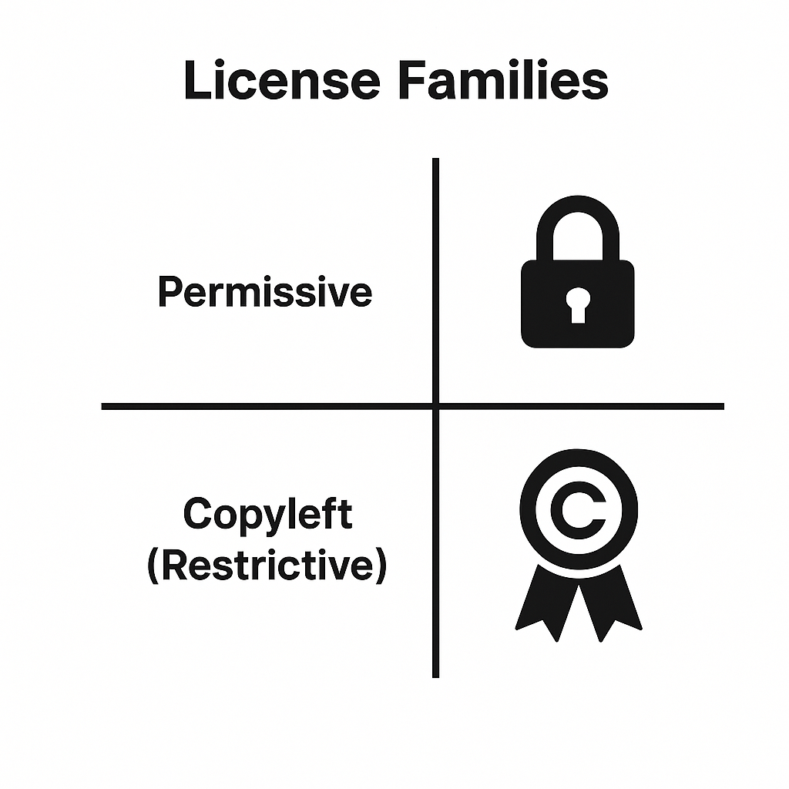
License Families: Permissive vs Copyleft (Restrictive)
Permissive (e.g., MIT, Apache‑2.0, BSD)
Broad reuse with minimal conditions
Attribution required; source disclosure generally not required
Copyleft (e.g., GPLv3, AGPLv3, LGPL)
Derivative works must remain under the same license (share‑alike)
AGPL adds network/SaaS disclosure obligation

Slide 4

MIT License — Quick Facts
Type: Permissive
Commercial use: Allowed
Attribution: Required (retain copyright & license notice)
Patent grant: No explicit patent license
Best for: Simple libraries, teaching code, examples

Slide 5

Apache License 2.0 — Quick Facts
Type: Permissive
Commercial use: Allowed
Attribution: NOTICE file; keep copyright & license
Patent grant: Yes (with termination on patent litigation)
Trademarks: Not granted
Best for: Larger projects, corporate/enterprise use

Slide 6

Creative Commons (CC) — Where It Fits
Great for datasets, documentation, media (not recommended for software code)
Common variants: CC BY 4.0 (attribution), CC BY‑SA 4.0 (share‑alike), CC0 1.0 (public domain dedication)
Check for Non-Commercial (NC) or No-Derivatives (ND) flags — they limit reuse
Always include attribution and license text when sharing

Slide 7
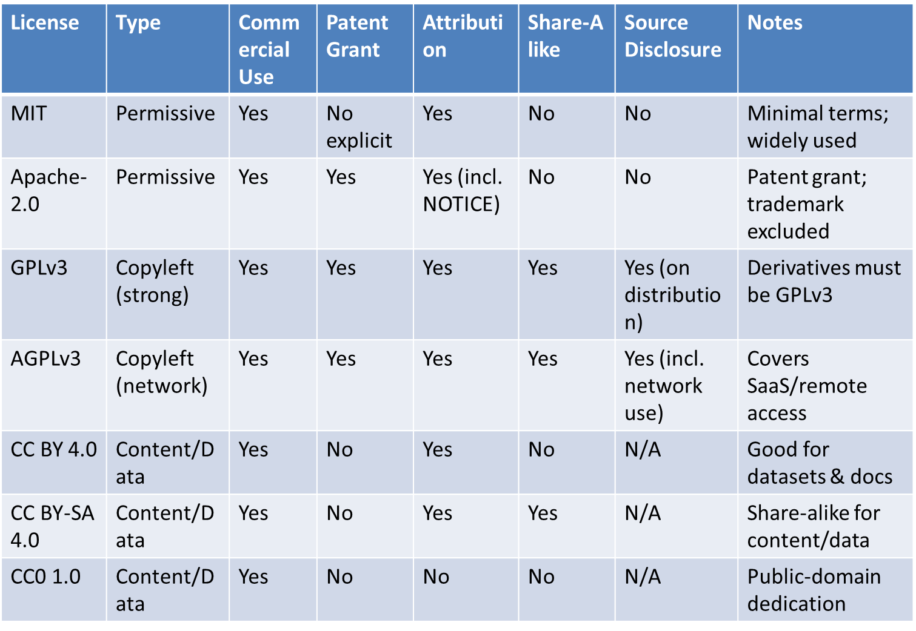
License Comparison at a Glance

Slide 8

Proper Citation — Why & What
Gives credit to creators; enables reproducibility
Clarifies licensing & permitted uses
Tells others exactly which version you used
Helps resolve disputes and audit results later

Slide 9

How to Cite Code, Models, and Datasets
Code (GitHub/Repo)
Author/Org (Year). Project Name (Version) [Source code]. License. URL. Accessed YYYY‑MM‑DD.
Model (e.g., model hub)
Author/Org (Year). Model Name (Version) [Computer software]. License. URL/DOI. Accessed YYYY‑MM‑DD.
Dataset
Creator(s) (Year). Dataset Name (Version) [Data set]. License. DOI/URL. Accessed YYYY‑MM‑DD.

Slide 10
Example Citations (Templates)
Code: Doe, J. (2024). TimeseriesTools v1.3 [Source code]. MIT License. https://example.org/timeseriestools (Accessed 2025‑08‑16).
Model: ACME AI (2025). PriceForecaster‑Small v0.2 [Computer software]. Apache‑2.0. https://example.org/models/priceforecaster (Accessed 2025‑08‑16).
Dataset: MarketLab (2025). NVDA Daily OHLCV v3 [Data set]. CC BY 4.0. https://example.org/datasets/nvda‑ohlcv (Accessed 2025‑08‑16).

Slide 11
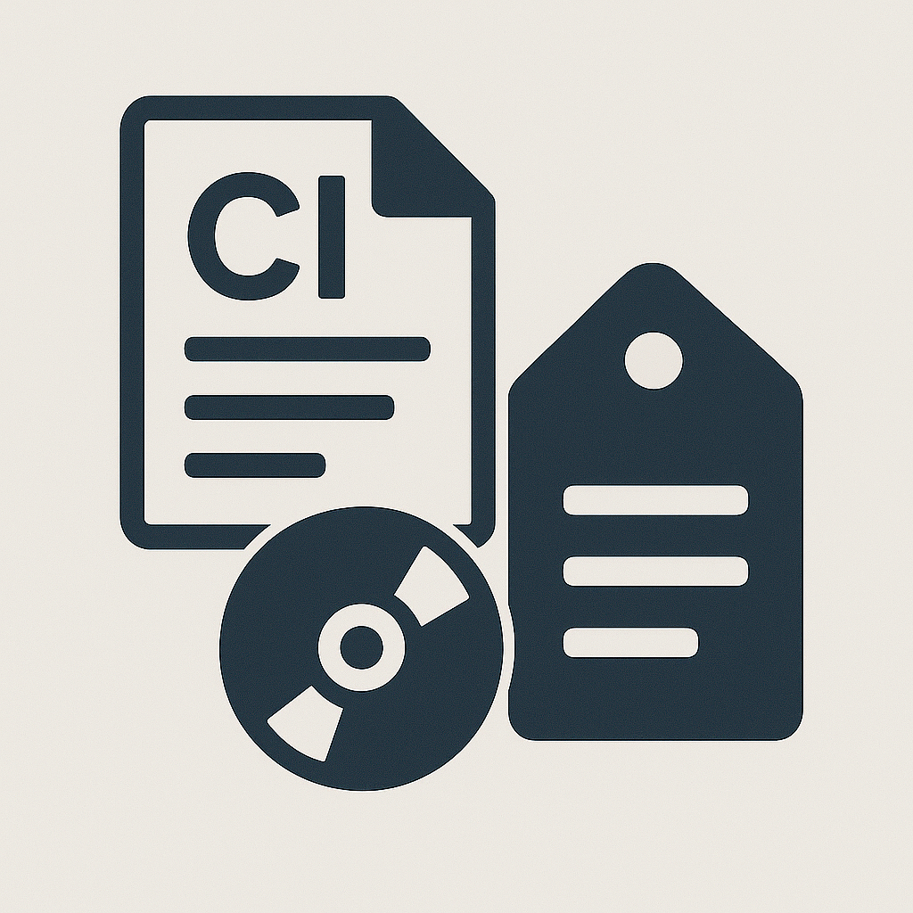
CITATION Files & Metadata
Include a CITATION.cff or CITATION.bib at your project root
Capture authors, title, version, release date, DOI/URL, license
Reference your dataset and model sources explicitly

Slide 12
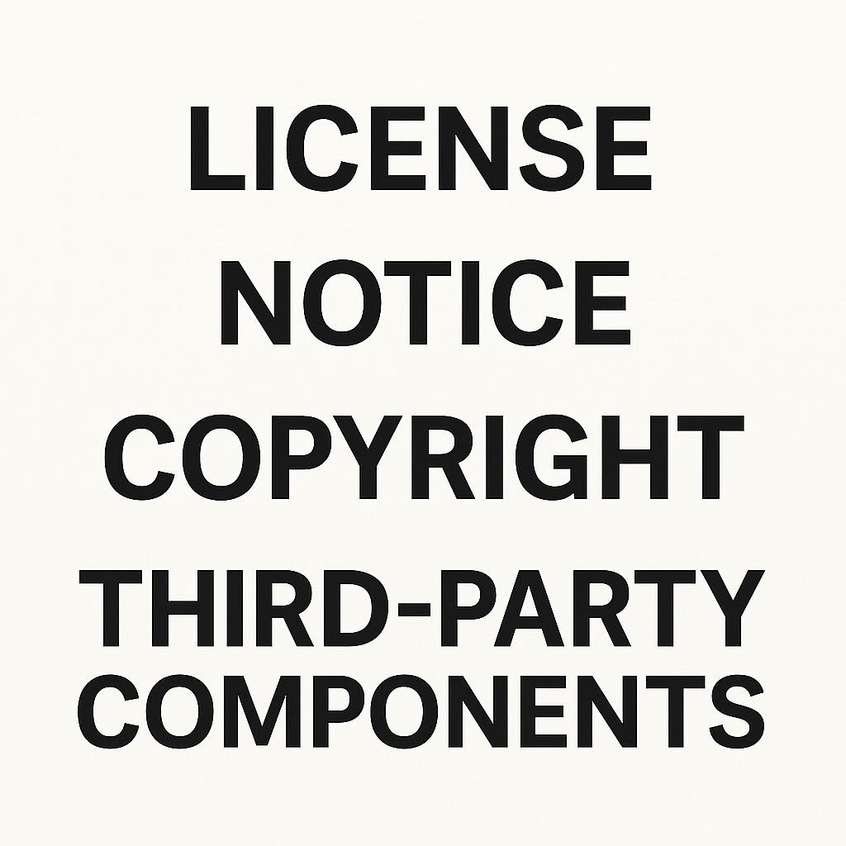
NOTICE & LICENSE Files
Always include a LICENSE file
Apache‑2.0: preserve and update NOTICE when required
Retain upstream copyright headers when reusing code
Document third‑party components and their licenses

Slide 13

Before You Publish — Compliance Checklist
Verify license compatibility among all components
Include LICENSE, NOTICE (if applicable), and CITATION files
Record versions, URLs/DOIs, and access dates for all dependencies
List third‑party attributions in README or a ‘licenses.txt’
State limitations and intended use to reduce misuse

Slide 14
Key License Links (Click to Open)
Apache License 2.0 (Official Text)
https://www.apache.org/licenses/LICENSE-2.0
MIT License (OSI)
https://opensource.org/licenses/MIT
Creative Commons Licenses (Overview)
https://creativecommons.org/licenses/
CC BY 4.0 (Legal Code)
https://creativecommons.org/licenses/by/4.0/
CC BY-SA 4.0 (Legal Code)
https://creativecommons.org/licenses/by-sa/4.0/
CC0 1.0 (Public Domain Dedication)
https://creativecommons.org/publicdomain/zero/1.0/

Slide 15
THANK YOU
Patrick Hill
phill86037@uat.edu
August 16, 2025
Note: Illustrations created by ChatGPT 5

